Slide 1

Big Mountain Resort
Guided
Capstone

Slide 2

Problem Statement
Big Mountain Resort hosts 350,000 visitors annually and offers facilities for both skiing and snowboarding
Ticket prices are set at a premium above average prices for similar resorts
The current pricing strategy does not reflect the unique facilities that Big Mountain offers
A new strategy should be implemented to increase resort revenue

Slide 3
Recommendations
Increase ticket price from $81.00 to $95.87 based on existing target features that set Big Mountain Resort apart from competing resorts
Invest in further improving these unique features, such as the vertical drop
Without additional information, it is not recommended to engage in cost-cutting scenarios such as closing runs

Slide 4
Big Mountain Resort Summary Information & Target Features
State/Region: Montana
Weekend/Weekday Ticket Price: $81.00
Target Features
Vertical Drop: 2353 ft.
Area Covered by Snow Makers: 600 acres
Number of Fast Quads: 3
Longest Run: 3.3 miles

Slide 5
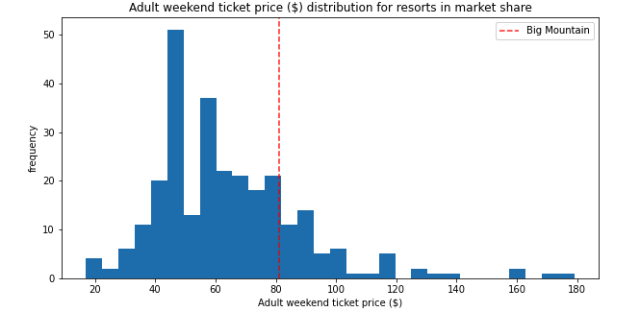
Big Mountain Comparison Ticket Price

Slide 6
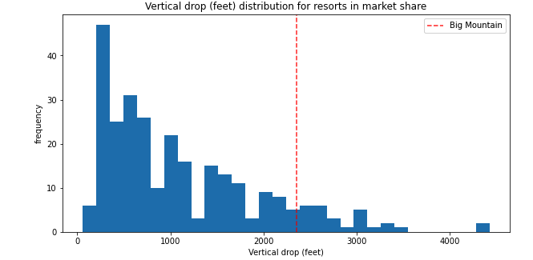
Big Mountain Comparison Vertical Drop

Slide 7
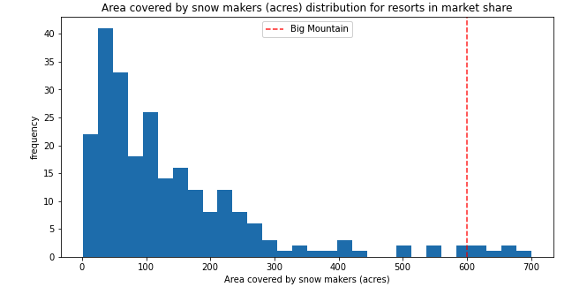
Big Mountain Comparison Snow Makers

Slide 8
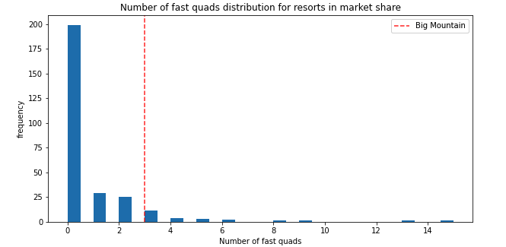
Big Mountain Comparison Fast Quads

Slide 9
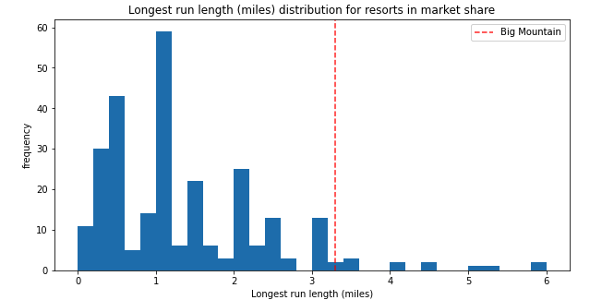
Big Mountain Comparison Longest Run

Slide 10
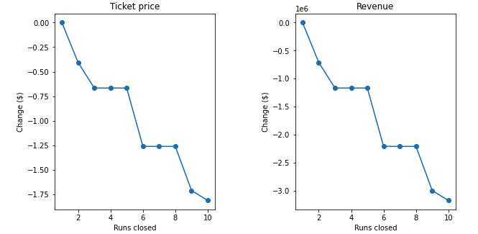
Scenarios
Not Recommended Scenario:
Close 10 Least Used Runs
Recommended Scenario:
Increase Vertical Drop By 150 ft. Add Additional Chair Lift
Supported Ticket Price Increase: $8.61
Additional Chair Lift Cost: $1.5 million
Expected Total From Ticket Increase: $15,065,471
Decrease In Supported Ticket Price
Insufficient Data to Determine Savings

Slide 11
Summary
In comparison to similar resorts, Big Mountain Resort offers superior target features. As a result, our model predicts support for higher ticket prices.
An investment in further improving these features could also increase revenue for the resort.

